Slide 1
Programming smartphones using CLDC/MIDP
Prepared by George Nguyen

Slide 2
Objectives
High level UIs
Using the MIDP Screen classes
TextBox Screens
Commands for user input
Alert Screens
Images
List Screens
Forms
Low level UIs

Slide 3
Recall previous tutorial
Did any one append TextBox in a Form?

Slide 4
Part I

Slide 5
High-Level UI API
GUI Components for creating user interfaces
Portable across MIDP compatible devices
Same look and feel
Very little control over look and feel
All high-level controls are Displayables and they are subclasses of the Screen class
Your application should create new instances of or extend the provided Screen classes like Form and Alert
This ensures you application has a consistent user interface throughout
Displayable
Screen
Canvas
Alert
Form
List
TextBox
GameCanvas
Notes:
MIDP defines two different ways to interact with the user: the screen and the canvas. Whereas screens implement high-level APIs that define how the user interface components look on the device and thus are portable, the canvas is a low-level API, is non-portable and provides the developer with almost complete control over how the user Interface appears. The canvas is particularly geared towards rich applications such as mobile games.
Screen is a common superclass of all high-level user interface classes. Subclassess defines the contents
that are displayed and their interaction with the user.
The application may change the contents of a Screen object while it is shown to the user by using
subclass-defined methods, like List.append(string,image).
If this occurs when the Screen object is visible, the display will be updated automatically.
Example: List object is currently displayed, and every element of the List is visible.
Application inserts a new element at the beginning of the List
It is displayed immediately, and the other elements will be rearranged appropriately
There is no need for the application to call another method to refresh the display.
UI5 - The application’s user interface should be consistent throughout, e.g. common series of
actions, action sequences, terms, layouts, soft button definitions and sounds.
To make sure your application screens, error messages etc have a consistent UI, you should
create new class by extending Form/Alerts with the chosen layout for your application. You can
then use/extend these new classes to create the elements in your application. Use static final
constants for terms, soft button definition and sounds. This way, you can use these throughout
your application consistently.

Slide 6
Displaying Controls and appending items to controls
Get the current display and set the current display to your control
Display display = Display.getDisplay(midlet);
Form form = new Form(“MyForm”);
display.setCurrent(form);
Create list control and add items to it
List list = new List(“My List”, Choice.IMPLCIT);
list.append(“first”, null);
list.append(“second”, null);
list.append(“third”, null);
display.setCurrent(list);
Notes:
Constructing a component using the high-level API is straightforward. The important thing to remember that there can only be one current component per screen unless you are using a Form and form items to show multiple components. Also, all high-level components are located on the javax.microedition.lcdui package so you need to import that package to use the controls.
Here's an example of how to grab the current display and set it to your component:
class MyMIDlet extends MIDlet {
Display display;
void init() {display = Display.getDisplay(this); }
Once you have the display, you can use the object to set the current display to a control that you want to display. For example:
void showAlert() {
Alert alert = new Alert(“Alert”);
alert.setType(AlertType.ERROR);
alert.setString(“*****ERROR*****”);
display.setCurrent(alert); } // set the current display
And that's it! Once you do that your control will be displayed as the current screen.
Appending Items to a control
Certain controls – namely list boxes and choice controls – allow the programmer to attach items for the control to manage. Here's a code snippet that shows how to attach items to a list control:
void shotList() {
list = new List(“My List”, Choice.IMPLCIT);
list.append(“first”, null);
list.append(“second”, null);
list.append(“third”, null);
display.setCurrent(list); }
Now, the user has 3 options to choose from.

Slide 7
Setting CommandListener to a control
Define the MIDlet to implement the CommandListener
class MyMIDlet extends MIDlet implements CommandListener
Create a control and set the CommandListener
class MyMIDlet extends MIDlet implements CommandListener {
…
List myList = new List("MyList", List.EXCLUSIVE );
myList.setCommandListener( this );
…
}
Notes:
Setting a command listener to a control
In the previous example, we demonstrated how to append items to a list. How do you determine which item was selected by the user? As with menu event handlers for screens, this is accomplished through the implementation of the CommandListener interface. The following example shows how easy it is for the list control to dispatch selection events:
class MyMIDlet extends MIDlet implements CommandListener {
List list;
Display display;
// code ommitted for setting the display object
public void commandAction(Command c, Displayable d) {
List l = display.getCurrent();
switch(l.getSelectedIndex()) {
case 0: break; // first
case 1: break; // second
}
}
The only thing that you need to be aware of with the above example is that you make sure you process any menu commands attached to the screen as well. For example:
Command backCommand = new Command(“Back”, Command.BACK,0);
public void commandAction(Command c, Displayable d) {
if (c == backCommand)
// go back to last screen
else
List l = display.getCurrent();
switch(l.getSelectedIndex()) {
case 0: break; // first
case 1: break; // second
}
}

Slide 8
Screen Types
Two types of screens for the high-level API
Simple screens that show one control at a time
Complex screens called Forms that can group controls together
Only one type of screen can be shown at a time on the display
This screen should only be displayed for the time necessary to read its information
You should try to limit the number of screens that the user has to browse through
Try to combine information on screens with limited content
Notes:
UI2 - Each screen must appear for the time necessary to read all its information
The developer, depending on the nature of the usage, should decide how long a screen should be displayed for.
UI12 - The number of screens a user has to browse through must be minimal
Minimizing the number of screens means the user is less likely to get lost within the application. There are a number of ways in which you can keep the number of screen the user has to page through to a minimum. On way is to try to combine the information on multiple screens with limited content. Another idea is to implement shortcuts in your application, which take the user directly to the main areas of the application, without having to trawl through menus and other screens.

Slide 9
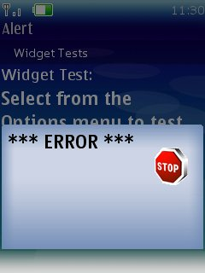
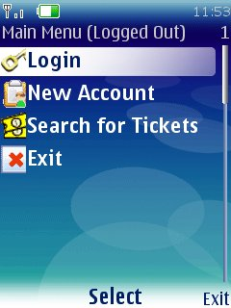
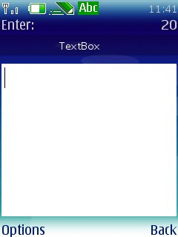
Simple Screens
Use them for simple user input
Alert
List
Textbox

Slide 10
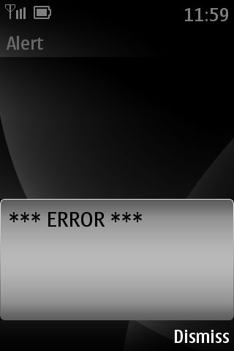
Alert
Use the Alert control for notifications
Alerts are like modal dialogs and can close themselves with a timeout
They are particularly useful for displaying error messages
Alert alert = new Alert(“Alert”);
alert.setType(AlertType.ERROR);
alert.setString(“*** ERROR ****”);
display.setCurrent(alert);
Ensure the error message is clearly understandable
Use human-readable language
Use precise descriptions and constructive advice
Notes:
Alert
Alerts now have the ability to attach custom commands and progress/activity indicators. The following code illustrates how to attach a custom command and an activity gauge:
Alert alert = new Alert("Title","Message",null, null);
alert.setTimeout(5000);
Gauge indicator = new Gauge(null, false, Gauge.INDEFINITE, Gauge.CONTINUOUS_RUNNING);
alert.setIndicator(indicator);
alert.addCommand(okCommand);
alert.addCommand(backCommand);
alert.setCommandListener(this);
display.setCurrent(alert);
In the above example, note the use of the , Gauge.INDEFINITE, Gauge.CONTINUOUS_RUNNING flags which are new to MIDP 2.0 as well. This flags indicate that the gauge does not have an endpoint to the activity and are typically used in conjunction with user determined activities such as the Alert above.
UI9 - Any error messages in the application must be clearly understandable. Error messages must clearly explain to the user the nature of the problem, and indicate what action needs to be taken (where appropriate).
As the slide explains, you can use an Alert to display an error message. To make the error message clearly understandable set the Alert type to be AlertType.ERROR. This way, the implementation will know to display a box that represents an error. Set the title of the alert to be something relating directly to the problem and ensure the text of the error provides constructive advice using a human-readable language (not obscure codes) and precise description of the problem.

Slide 11
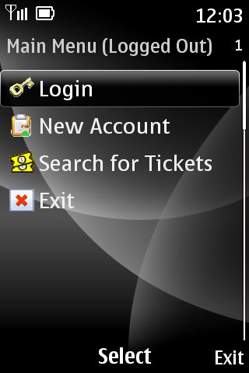
List (1)
Use List controls to display choices to the user
List list = new List(“Main Menu”,
Choice.IMPLICIT);
list.append(“Login”, image1);
list.append(“New Account”, image2);
list.append(“Search for Tickets”, image3);
list.append(“Exit”, image4);
display.setCurrent(list);
Notes:
List
A List control now has the ability to set the selected command which will be the default when the List is first instantiated. This allows for flexible command handling than using List.SELECT_COMMAND and now MIDlets can define command dispatchers more cleanly. This is valid for implicit lists and the code could like this:
List list = new List("Title", Choice.IMPLICIT);
list.setCommandListener(this);
Command defCommand = new Command("Default", Command.ITEM, 1);
list.addCommand(defCommand);
list.setSelectCommand(defCommand);
// now can define event dispatch
public void commandAction(Command cmd, Displayable d) {
int selIdx = ((List) d).getSelectedIndex();
if (cmd == defCommand) { // do something with selIdx
}
}
Choice.MULTIPLE (CheckBox), EXCLUSIVE(Radio Button), IMPLICIT (Menu)
If a text item in a List is too long to fit on a single line, we now have policies that we can use that indicate how we wish to manage the items thereof. We can either choose to wrap the text or use the default mechanism:
list.setFitPolicy(List.TEXT_WRAP_ON);// wraps text
Next, we can now set different fonts for elements within a list. The code to do this looks like this:
// Get a new font with only the style differing from default font
Font newFont = Font.getFont(list.getFont(0).getFace(), Font.STYLE_BOLD | Font.STYLE_ITALIC, list.getFont(0).getSize());
for (int i = 0 ; i < list.size() ; i++) {
// some boolean array that determines if we use the new font
if (!fontStyle[i]) {
list.setFont(i, newFont);
}
}

Slide 12
List (2)
Implement CommandListener interface to dispatch list events
public void commandAction(Command c, Displayable d) {
List list = (List)display.getCurrent();
switch(list.getSelectedIndex()) {
case 0: break;
case 1: break;
}
}

Slide 13
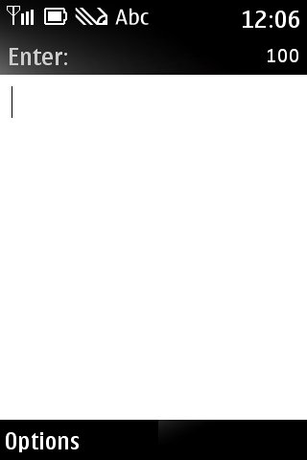
TextBox
Use the TextBox control to accept user input
TextBox textBox = new TextBox(“Enter:”,””,100,TextField.ANY);
display.setCurrent(textBox);

Slide 14
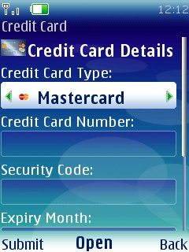
Complex Screens - Forms
Form class acts as a container for form items.
Form Items:
TextField
StringItem
DateField
ImageItem
Gauge
CustomItem
ChoiceGroup

Slide 15
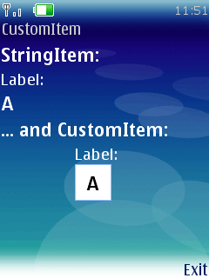
CustomItem
Customizable by subclassing to introduce new visual and interactive elements into Forms
Subclasses are responsible for
Visual appearance (sizing, rendering, colors etc.)
User interaction mode by responding to events generated by keys, pointer actions, and traversal actions
Calling Item.notifyStateChanged() to trigger notification of listeners that the CustomItem's value has changed.
Notes:
Custom Items
Finally, if you are completely dissatisfied with the widget elements provided with MIDP 2.0, you are free to implement your own owner-drawn items which sublass CustomItem. The complete visual appearance and user interaction is completely implemented and defined by the programmer so now there is virtually limitless design freedom when it comes to designing MIDP user interfaces. The programmer must override the getMinContentHeight(), getMinContentWidth(), getPrefContentHeight(), and getPrefContentWidth() methods to tell the MIDlet how to respond to size changes. In addition, sizeChanged() and paint() must also be implemented and when the MIDlet needs to redraw the CustomItem, it needs to call invalidate() method to force a repaint. If the CustomItem wishes to dispatch events then it can also implement the ItemListener interface and the implement the notitfyStateChanged() method
class MyCustomItem extends CustomItem
public CustomItem (String string) {
this.super(string);
}
ing getMinConentHeight() {
// return min height
return HEIGHT/2 – 138;
}
int getMinContentWidth() {
// return min width
return WIDTH/2 – 150;
}
int getPrefConetntHeight(itnt width) {
return WIDTH/2;
}
int getPrefContentWidth(int height) {
return HEIGHT/2;
}
void paint(Graphics g, int width, int height) {
int x = (WIDTH - 150) / 2;
int y = (HEIGHT - 138) / 2;
g.setClip(x, y, 150, 138);
drawMenuTitleBackground(x, y, 150, 138);
g.setFont(canvasFont);
g.setColor(LIGHTGREEN);
g.drawChars(TEXT, 24, 6, x + 10, y + 5, 20);
g.setColor(RED);
g.fillRect(x + 2, y + 22 + 20 * menuEntry, 146, 15);
g.setColor(WHITE);
g.drawChars(TEXT, 11, 6, x + 30, y + 25, 20);
g.drawChars(TEXT, 17, 7, x + 30, y + 45, 20);
}

Slide 16
Form Layout
Forms have layout control
In MIDP 1.0 only horizontal layout
In MIDP 2.0
LAYOUT DIRECTIVE | DESCRIPTION
LAYOUT_DEFAULT | Default layout (leave it up to the implementation)
LAYOUT_LEFT | Align the item to the left
LAYOUT_RIGHT | Align the item to the right
LAYOUT_CENTER | Center the item
LAYOUT_TOP | Align to the top
LAYOUT_BOTTOM | Align to the bottom
LAYOUT_VCENTER | Vertically center the item
LAYOUT_NEWLINE_BEFORE | This item will start on a new line
LAYOUT_NEWLINE_AFTER | This item will be the last one on a line (with a new line starting immediately after)
LAYOUT_SHRINK | Allow this item to shrink to the minimum width if required
LAYOUT_VSHRINK | Allow this item to shrink to the minimum height if required
LAYOUT_EXPAND | Expand the item as wide as possible
LAYOUT_VEXPAND | Expand the item as high as possible
LAYOUT_2 | Indicate that MIDP 2 layout is in effect for this item

Slide 17
Displaying Form Items
Displaying items on a form is easy
Form form = new Form(“form);
StringItem item = new StringItem(“text”,”text”);
form.append(item); // display it
Removing items on a form is easy
form.delete(0); // delete first item
form.deleteAll(); // delete them

Slide 18
Form Items - TextField
Use TextFields to accept user input as text
TextField textField = new TextField(“TextField Label”,”some text”,20,0);
form.append(textField);
Accepts characters depending on default device language
Input constraints can be applied when constructing a TextField by selecting on of the following:
TextField.ANY - The user is allowed to enter any text.
TextField.EMAILADDR - The user is allowed to enter an e-mail address.
TextField.NUMERIC - The user is allowed to enter only an integer value.
TextField.PHONENUMBER - The user is allowed to enter a phone number.
TextField.URL - The user is allowed to enter a URL.
TextField.DECIMAL - The user is allowed to enter only a decimal value.
Notes:
SE3 - The application must not echo the input of sensitive data, e.g., pins and passwords
Your application should use the TextField class for password input box. To ensure the TextField does not echo the input of sensitive data, you should set the value of the input constraints parameter to TextField.PASSWORD
LO2 - Data entry fields must accept and properly display International characters.
TextField supports all input modes available in native text editing. The default input mode is set dependent on the user interface language of the device. In MIDP 2.0, you can use the setInitialInputMode method to define the active input mode, however, this is only a hint to the implementation.

Slide 19
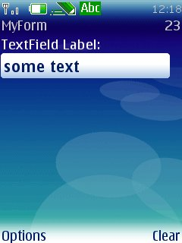
Form Items - TextField
You can also set following additional constraints:
TextField.PASSWORD - The text entered must be masked
TextField.UNEDITABLE
TextField.SENSITIVE
TextField.NON_PREDICTIVE
TextField.INITAL_CAPS_WORD
TextField.CAPS_SENTENCE
To set constraints after constructing, use setConstraints method
Notes:
SE3 - The application must not echo the input of sensitive data, e.g., pins and passwords
Your application should use the TextField class for password input box. To ensure the TextField does not echo the input of sensitive data, you should set the value of the input constraints parameter to TextField.PASSWORD
LO2 - Data entry fields must accept and properly display International characters.
TextField supports all input modes available in native text editing. The default input mode is set dependent on the user interface language of the device. In MIDP 2.0, you can use the setInitialInputMode method to define the active input mode, however, this is only a hint to the implementation.

Slide 20
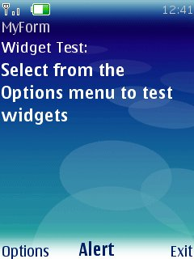
Form Items - StringItem
Use StringItem to display static text
String str = “Select from the Options menu to test widgets”;
StringItem stringItem
= new StringItem(“Widget Test:”, str);
form.append(stringItem);
Notes:
Items
All items now allow individial event listeners to be attached directly to the form item. Items can now also modify the labels in addition to the textual content after the Item is created. The following code shows how to attach a listener to a StringItem, which new Item in MIDP 2.0 that allows for non-textual descriptors to be placed on a Form:
StringItem stringItem = new StringItem(“Here”, “There”, Item.BUTTON);
stringItem.setDefaultCommand(new Command(“There”, Command.ITEM, 1));
stringItem.setItemCommandListener(myItemCmdListener);
StringItems and ImageItems now also have new appearance modes: PLAIN, BUTTON and HYPERLINK. The above example constructs a SringItem to appear as a button and attach a command to that button that is activated when the button is pressed.

Slide 21
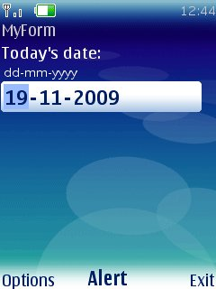
Form Items - DateField
Use DateField to display dates
DateField dateField = new DateField(“Date:”, DateField.DATE);
java.util.Date date = new java.util.Date();
dateField.setDate(date);
form.append(dateField);
Displays the date in the correct format for default device time zone
Notes:
LO1 - Data format must be handled appropriately for the targeted country
Always use the DateField class for displaying/entering dates and times. This is especially useful when thinking about localisation, as when using the DateField class, the date is displayed correctly for the default time zone of the device the application is running on.

Slide 22
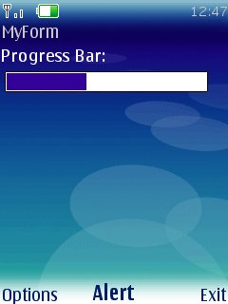
Form Items - Gauge
Use Gauge to display values in a range as a bar graph if non-interactive or ascending arc if interactive
Use setValue() to change the position of the current level in the bar graph
Useful for displaying progress screens
// 2nd parameter determines if
// interactive or not
Gauge gauge = new Gauge(“Progress Bar”,
false, 25, 10);
form.append(gauge);
Notes:
UI13 - Any selection of a different function in the application should be performed within 5 seconds. Within 1 second, there must be some visual indication that the function will be performed
A Gauge can be used to show progress. Your application should update the Gauge as parts of the task are completed, using the setValue method
UI13 - Any selection of a different function in the application should be performed within 5 seconds. Within 1 second, there must be some visual indication that the function will be performed
A Gauge can be used to show progress. Your application should update the Gauge as parts of the task are completed, using the setValue method

Slide 23
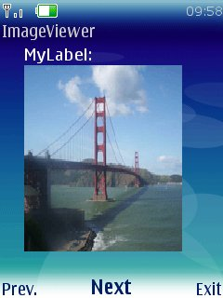
Form Items - ImageItem
Use ImageItem to display images on the Form
If you don't care about layout then you can append an Image directly
Image image = Image.createImage(“/sf.png”);
int pos = ImageItem.LAYOUT_CENTER;
ImageItem imageItem
= new ImageItem(“MyLabel”, image, pos, “alt”);
form.append(imageItem);
Notes:
Slide shows an example how to append ImageItem to a form.
To append the image directly to a form: form.append(image);

Slide 24
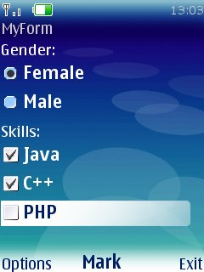
Form Items - ChoiceGroup
Use ChoiceGroup to present a selection of choices to the user
ChoiceGroup cg = new ChoiceGroup(“Gender”, ChoiceGroup.EXCLUSIVE);
gender.append("Female", null);
gender.append("Male", null);
form.append(cg);
Useful when displaying application settings
Provides a clear way to present the status of a setting
Two possible types:
ChoiceGroup.EXCLUSIVE – one selected at a time
i.e. radio buttons
ChoiceGroup.MULTIPLE - multiple number selected at a time
i.e. check boxes
Notes:
UI17 - The current status of each setting is clear: the application should make use of check boxes or by changing text.
As the slide shows, a ChoiceGroup can be used to display setting within your application. Check boxes can be implemented by, setting the type to Choice.MULTIPLE

Slide 25
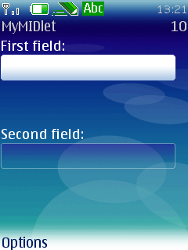
Form Items - Spacer
Use Spacers for non-interactive spaces to help position controls
Spacer space = new Spacer(10,20);
form.append(space);
Notes:
Spacers and Layout
One of the problems with MIDP 1.0 (especially dealing with Forms) was how to place Items on the screen in aesthetic manner. What was sorely needed was a way to space items and to lay items out according to different affinities. Both of these actions are now supported in MIDP 2.0. Spacers are non-interactive items that specify a minimum size in width and height. The new layout affinities such as LAYOUT_BOTTOM, LAYOUT_CENTER, LAYOUT_NEWLINE_AFTER aid in the positioning of form items in the most aesthetic manner. Here’s an example of how to use the new layout directives (see the image from slide to see how it looks in display):
Form form = new Form( "MyMIDlet" );
TextField textField = new TextField( "First field", "", 10, TextField.ANY );
textField.setLayout( Item.LAYOUT_2 | Item.LAYOUT_SHRINK | Item.LAYOUT_VSHRINK | Item.LAYOUT_RIGHT | Item.LAYOUT_TOP );
form.append( textField );
Spacer space = new Spacer( form.getWidth(), 50 );
form.append( space );
TextField textField2 = new TextField( "Second field", "", 10, TextField.ANY );
textField2.setLayout( Item.LAYOUT_2 | Item.LAYOUT_SHRINK | Item.LAYOUT_VSHRINK | Item.LAYOUT_RIGHT | Item.LAYOUT_TOP );
form.append( textField2 );
getDisplay().setCurrent( form );
Note that the MIDP 2.0 algorithm for item layout is done each row at a time and if an Item cannot fit on a row then a new row is created, so the directive Item.LAYOUT_2 instructs the layout manager to use this algorithm. For backwards compatibility, the flag directive Item.LAYOUT_1 could also be used.

Slide 26
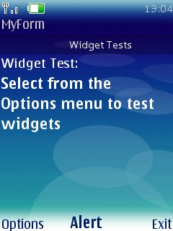
Form Items - Tickers
Tickers are scrolling text information that appears on the screen
You can attach a Ticker to any Displayable except Canvas
Form form = new Form(“MyForm”);
form.setTicker(new Ticker(“Widget Tests”));
Ticker
Notes:
Tickers are scrolling display items that you can attach to a screen item. Typically they are used to display some form of current information such as stock market price information. Tickers can be attached to screen item like this:
// using the same list examples
void setListTicker() {
list.setTicker(new Ticker(“a ticker tape));
}

Slide 27
Menus (1)
Menus can attach to screens.
Menu options created using Command object with the parameters:
Command label, e.g. “Exit”
Command Type, e.g. Command.EXIT
Command Priority, e.g. 0 (which means the command should be positioned to the top of the menu)
To implement a menu, implement the CommandListener interface
The CommandListener interface dispatches Command objects
Override the commandAction method and listen for Command events
Notes:
UI6 - Where the application uses menu or selection items, the function of the selection and menu items must be clearly understandable to the user. Further, each menu or selection item must perform a valid action (i.e. no menu orphans.)
When adding the command label, you should ensure it appropriate for the target audience. Ideally, the label of the selected command should be reflected in the title of the resultant screen. The order of commands must be considered in your application also. For example, the most relevant command for currenct application state should be at the top, while something such as an ”Exit” command should be at the bottom.

Slide 28
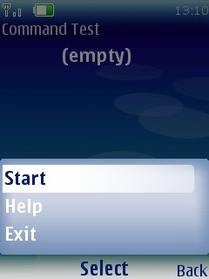
Menus (2)
Some uses of menus: Option to Display the Help or Exit the application
class MyForm extends Form
implements CommandListener {
Command exitCmd =
new Command(“Exit”, Command.EXIT, 2);
public MyForm() {
super(“Command Test”);
super.addCommand(exitCmd);
super.setCommandListener(this);
}
public void commandAction(Command c,
Displayable d) {
if (c == exitCmd)
exit();
}
}
Notes:
FN1 - An exit functionality is explicitly present in the application (e.g. in a Main Menu)
For every screen in your application, you should have a way to exit the whole application. This can be done by adding a Command with type Command.EXIT to each Form, Alert, Canvas etc. You must ensure that the ”Exit” functionality in your application calls destroyApp then notifyDestroyed. The destroyApp method must release all resources that your application has been using
UI4 - If applicable, the main functionalities of Exit, About and Help must be accessed easily through a Main Menu.
You can create a main menu using Commands

Slide 29
Making the application listen for Commands
To make an application respond to a Command an object has to be listening for the command to be invoked
A Listener is specified using the setCommandListener() method e.g.
mTextBox.setCommandListener(this);
the Screen whose commands are going to be listened for
the object that will handle the Command
The Listening object must implement the CommandListener interface and contain a method called commandAction()
Notes:
this is a reference to the current object. So if you code mTextBox.setCommandListener(this) in your MIDlet it means that the MIDlet itself will handle the command.

Slide 30
Making the application respond to Commands
The code to be run when the user selects the Command must go in the commandAction() method of the object specified as the Listener e.g.
public class CommandDemo1 extends MIDlet
implements CommandListener {
.....
public CommandDemo1() {
.....
mTextBox.addCommand(new Command("Exit", Command.EXIT, 0));
mTextBox.setCommandListener(this);
}
public void commandAction(Command c, Displayable d) {
if (c.getLabel().equals("Exit")) {
notifyDestroyed();
}
}
…..
Code run when the command is invoked

Slide 31
Full Example (1)
public class EventDemo extends MIDlet implements CommandListener {
private Command exit, cmd;
private Form myForm;
public EventDemo() {
exit = new Command("Exit", Command.EXIT, 0);
cmd = new Command("Command", Command.OK, 0);
myForm = new Form("My Form");
}
public void startApp() {
Display mDisplay = Display.getDisplay(this);
mDisplay.setCurrent(myForm);
myForm.addCommand(exit);
myForm.addCommand(cmd);
myForm.setCommandListener(this);
}
Implement CommandListener Interface
Register CommandListener

Slide 32
Full Example (2)
public void pauseApp() { }
public void destroyApp(boolean unconditional) { }
public void commandAction(Command cmnd, Displayable dsplbl) {
if(cmnd==exit){
System.out.println("Exit Command is clicked");
}
if(cmnd==cmd){
System.out.println("Cmd Command is clicked");
}
}
}
Override CommandAction to perform what we want to handle

Slide 33
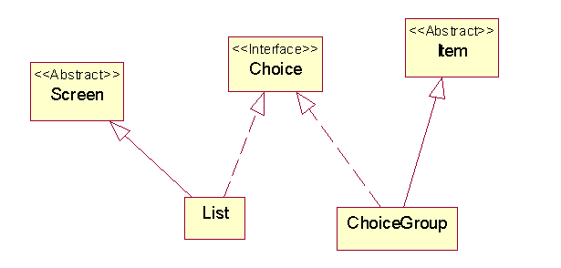
Choice Interface
Refer the source code of ChoiceGroup.java for more information
http://jcs.mobile-utopia.com/jcs/61093_ChoiceGroup.java

Slide 34

ItemStateListener
Most items in a Form fire events when the user changes them.
Your application can listen for these events by registering an ItemStateListener with the Form using the following method:
public void setItemStateListener(ItemStateListener iListener)
ItemStateListener is an interface with a single method and it is called every time an item in a Form is changed:
public void itemStateChanged(Item item)
Example: To update the numeric value when the progress bar (gauge) is changed, you need to use the ItemStateListener

Slide 35
Full Example (1)
public class GaugeTracker extends MIDlet implements ItemStateListener, CommandListener {
private Gauge mGauge = new Gauge("GaugeTitle", true, 5, 3);
private StringItem mStringItem = new StringItem(null, "[value]");
public GaugeTracker() { itemStateChanged(mGauge); }
public void itemStateChanged(Item item) {
if (item == mGauge)
mStringItem.setText("Value = " + mGauge.getValue());
}
public void commandAction(Command c, Displayable s) {
if (c.getCommandType() == Command.EXIT)
notifyDestroyed();
}
Implement ItemStateListener Interface
Overide itemStateChanged() to handle when an Item' State in a form changes

Slide 36
Full Example (2)
public void startApp() {
Form form = new Form("GaugeTracker");
form.addCommand(new Command("Exit", Command.EXIT, 0));
form.setCommandListener(this);
// Now add the selected items.
form.append(mGauge);
form.append(mStringItem);
form.setItemStateListener(this);
Display.getDisplay(this).setCurrent(form);
}
public void pauseApp() { }
public void destroyApp(boolean unconditional) { }
}
Register ItemStateListener for a Form. Elements that can signify their state’s changes can be captured.

Slide 37
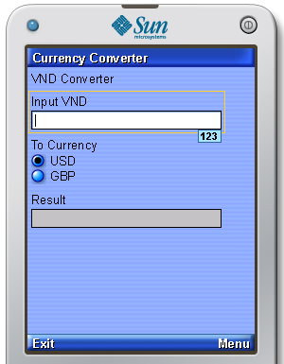
Put it all together - DEMO

Slide 38
MIDP 2.0 additions to high-level UI
The high-level has added some new classes as well as improving on existing ones.
New classes Spacer, StringItem and ItemListener
New layout flags for better Form item placement
Appearance flags for StringItem and ImageItem
Items can now attach CommandListener
CustomItem allows the programmer complete control over how a Form item looks and acts
Lists can now set default actions
Set Fonts for elements in a ChoiceGroup and List
Notes:
Some new classes and improved functionality of the MIDP 1.0 classes have been added that dramatically improve programmer control over the high-level UI. Notably the following improvements have been made:
Ability to control backlight and vibrator
New methods for managing styles and colours including alpha values for colours
Methods to query preferred image dimensions for use in lists
Commands can implement short and long labels which are more aesthetic depending on the context of the where the command is used
Affinity identifiers that allow for more flexible layout of Form items
New classes StringItem, Spacer and CustomItem
New input constraints for TextBox class such as TextBox.PHONENUMBER and TextBox.DECIMAL and input modes for different character sets.

Slide 39
Part II

Slide 40
Low-Level UI API
Canvas class represents low-level drawing target
Graphics class represents 2D device context used to draw to Canvas
Developer responsible for all drawing
Developer responsible for event dispatching
Non-portable so MIDlet must adapt to the device
Notes:
Canvas subclasses javax.microedition.lcdui.Displayable and provides methods for obtaining screen geometry and other informative methods about the canvas. The Graphics class is then used to implement drawing on the Canvas with a number of different primitives. The important part for the developer is to remember that the developer is responsible for all drawing and event handling on the Canvas. The canvas provides the appropriate listener interfaces for handling key and pointer events and you can use the interfaces thereof to construct and control program logic.

Slide 41
Architecture
Can be used with High Level API
Use high-level API for common user input widgets
Can't combine high-level and low-level on same Displayable so you need separate Displayable
More Displayables means more memory: maybe better to implement everything with low-level API
Coordinate system: (0,0) upper left hand corner
MIDP 2.0 additions: full screen canvas and advanced image manipulation

Slide 42
Canvas (1)
LCDUI provides a Canvas and Graphics class
Canvas is a Displayable that displayed on-screen
These classes can be used to create low-level graphics, display images, and create animations
Displayable
Graphics
drawLine()
drawRect()
drawArc()
drawImage()
drawString()…
Canvas
paint(Graphics g)
...
Notes:
As well as providing classes to add high-level components to your using interfaces, LCDUI also provided class to allow you to draw low-level graphics to the screen. The main two classes are the Canvas class and the Graphics class.
The Canvas class is a displayable that can be displayed using the Display.setCurrent() method. It represents a blank rectangular area of the screen onto which the application can draw or from which the application can trap input events from the user.
An application must subclass the Canvas class in order to get useful functionality such as creating a custom component. The paint method must be overridden in order to perform custom graphics on the canvas.

Slide 43
Canvas (2)
Canvas subclasses Displayable
Developer overrides the paint() method:
protected void paint(Graphics g) {
// do some painting!
}
Developer overrides key event methods:
protected void keyPressed(int keyCode) {
// handle key code!
}
Notes:
Rendering the Canvas is done with paint() method. Subclass of the Canvas must implement this method in order to paint any graphics. The Graphics object's clip region defines the area of the screen that is considered to be invalid. paint() method must paint every pixel within this region. This is necessary because the implementation is not required to clear the region prior to calling paint() on it. Thus, failing to paint every pixel may result in a portion of the previous screen image remaining visible.
When a key is pressed, keyPressed() method is called. To determine what game action, if any, is mapped to the key, getGameAction() method can be called. Class Canvas has an empty implementation of this method, and the subclass has to redefine it if it wants to listen this method.

Slide 44
Canvas (3)
Can implement CommandListener interface to handle Command events:
MyCanvas extends Canvas implements CommandListener {
public void commandAction(Command c, Displayable d) { // do something with commands!
}
}

Slide 45
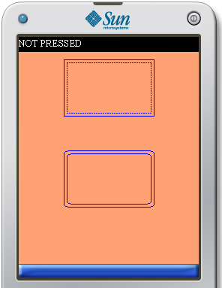
Drawing Graphic Primitives (1)
Provides methods for rendering to Canvas
Use stroke styles to control outline style of graphic primitives:
Solid
Dotted
Use fill methods to fill in primitives: Graphics.fillRect()
Stroke style does not affect fill
Colours can be set using Graphics.setColor()
Ensure you test out colour combinations on an actual device to make sure all the screens are clear enough to read
Notes:
As indicated above, the Graphics class provides methods for drawing 2D geometric graphic primitives. You can draw primitives such as rectangles, polygons, lines and even load static images. As rich as the API is, there are some limitations when drawing circles and other objects such as 3D objects which rely heavily on sine, cosine and other calculations involving floating points. Currently this is a limitation of the device configuration – namely CLDC 1.0 – which doesn't support floating points and will be addressed in the future. So you need some tricks to draw circles and 3D objects with the low-level API and in the accompanying lab we'll demonstrate how to do these sorts of things. Also note, that color selection is based on a 24 bit, red, green, blue model and you can specify colors like: 0xRRGGBB with 8 bits per color component. However note that not all displays are color so you should use the isColor() and numColors() methods as indicated above for determining the capabilities of your phone. One thing to remember is that backgrounds must also be redrawn each time the paint() method is invoked so be sure to call methods like setFillRect() to assure that you maintain the correct background color for your screen since there is no method to set the background color by default.
import javax.microedition.lcdui.*;
public class MyCanvas extends Canvas {
WIDTH = screen.getWidth();
m_screenHeight = screen.getHeight();
m_image = Image.createImage("/m031.png");
m_imageWidth = m_image.getWidth();
m_imageHeight = m_image.getHeight();
m_x = (m_screenWidth - m_imageWidth)/2;
m_y = (m_screenHeight - m_imageHeight)/2;
protected void paint(Graphics g)
{
g.drawImage(m_image, m_x, m_y, Graphics.TOP|Graphics.LEFT);
}
}
UI1 - All screen content must be clear and readable to the naked eye regardless of information displayed, or choice of font, color scheme etc
Avoid color schemes that are too close in hue, for example a dark blue background with a medium-range blue text. Also try to avoid color schemes that are too close in contrast, for example a dark blue background with dark purple text. When including any text on your application screens, use upper and lower case rather than full uppercase lettering, and try avoid putting too much text on the screen.

Slide 46

Drawing Graphics Primitives (2)
import javax.microedition.lcdui.*;
class MyCanvas extends Canvas {
public MyCanvas() {
super();
super.setFullScreenMode(true);
}
public void paint(Graphics g) {
g.setColor(255, 255, 0);
g.fillRect(0, 0, getWidth(),
getHeight());
g.setColor(0, 0, 0);
g.drawString("Hello There",
getWidth() / 2, 0,
Graphics.TOP | Graphics.HCENTER);
}
}
Notes:
Drawing to the screen is accomplished by first setting the drawable canvas as the current display from the MIDlet entry point.
import javax.microedition.midlet.*;
import javax.microedition.lcdui.*;
public class MyMidlet extends MIDlet {
public MyMidlet() { // constructor
Canvas canvas = new MyCanvas(this) }
public void startApp( ) {
Display display = Display.getDisplay(this);
display.setCurrent(canvas);
} }
After this, we can subclass the Canvas, and override a single method: paint(Graphics g) in order to draw to the screen:
import javax.microedition.midlet.*;
import javax.microedition.lcdui.*;
public class MyCanvas extends Canvas {
private MyMidlet midlet;
private boolean isColor;
private numColors = 0;
private int HEIGHT;
private int WIDTH;
public MyCanvas(MyMidlet midlet) {
this.midlet = midlet;
isColor = numColors();
if (isColor)
numColors = numColors();
HEIGHT = getHeight();
WIDTH = getWidth();
}
protected void paint(Graphics g){
g.setColor(0xffffff, 0xffffff, 0xffffff);
g.fillRect(0, 0, WIDTH, HEIGHT);
g.setColor(0, 0, 0);
g.drawString( "Some Text", WIDTH/2, 0, Graphics.TOP |
Graphics.HCENTER);
} }
Note use the utility functions numColors(), isColor() and the geometry metric methods as above to help you write the MIDlet in a portable fashion.

Slide 47
Fonts (1)
Use Font class to control text style
Fonts have attributes:
Style
Size
Face
Fonts use anchors with (x,y) coordinates to decide where to draw themselves
Anchor definitions can be ORd together
Only 1 Font at a time associated with the Canvas
Notes:
Fonts are used to control the way text appears on the canvas. Fonts are styled by three different attributes: Face, Size and Style. The style attribute can be ordered together to produce the desired font however the other attributes – face and size – must be singular. Font's always return a valid font object for a valid Font format which means that if a given font style specification is not available – i.e. the combination of face, size and style requested by the developer is not available – then the instantiation of the font returns the closest matching font format combination thereof. Positioning of the Font string is achieved with (X,Y) coordinates and the “anchor points” using MIDP terminology. Anchor points are hints as to the affinity of how the Font is drawn with respect to the (X,Y) position. Anchor points can be ordered together to produce the desired affinity. For example the anchor point LEFT | TOP would position the string towards the top left corner as being the starting location of the (X,Y) coordinate position of the string. The following example code should clarify:
import javax.microedition.lcdui.*;
public class FontCanvas extends Canvas {
public void paint(Graphics g) {
g.setColor(0xffffff);
g.fillRect(0, 0, getWidth(), getHeight( ));
g.setColor(0x000000);
g.setFont(Font.getFont(Font.FACE_SYSTEM, Font.STYLE_PLAIN,
Font.SIZE_LARGE));
g.drawString("System Font", 0, 0, Graphics..LEFT | Graphics.TOP);
}

Slide 48
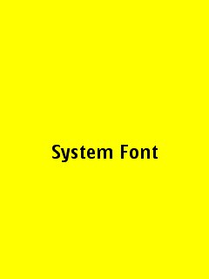
Fonts (2)
class MyClass extends Canvas {
public void paint(Graphics g) {
g.setFont(Font.getFont
( Font.FACE_SYSTEM,
Font.STYLE_PLAIN,
Font.SIZE_LARGE));
g.drawString("System Font",
getWidth()/2, getHeight()/2,
Graphics.TOP | Graphics.HCENTER);
}
}
Make sure you check all text that you display on screen
Does it make sense?
Is the spelling correct?
Will the target audience understand it?
Notes:
UI3 - Text should be understandable to the target user group. The application spelling and grammar should be correct. Text should not be truncated
Ensure that you know the audience of your application to be sure any text is understandable. For example, if your application is for scientific user, ensure that you use symbols and acronyms correctly, or if your application is aimed at young children don’t use complicated words or long sentences. Ensure to spell check all text that you use within your application.

Slide 49
Events (1)
Programmer responsible for all event dispatching
Events generated when:
Key is pressed
Pointer is used (if available)
Display is painted
Implement the CommandListener interface
Display is hidden/shown
This may happen when there is an incoming call, text message or posting of an error message
hideNotify() and showNotify() methods are called on the Canvas when display is hidden/shown.
Notes:
As with drawing, all input events and other canvas notifications is the responsibility of the developer to manage. At the very minimum you need to override the keyPressed() event to exit the MIDlet otherwise there is no way for the MIDlet to exit with end-user control.
import javax.microedition.midlet.*;
import javax.microedition.lcdui.*;
public class MyCanvas extends Canvas {
MyMidlet midlet;
public MyCanvas(MyMidlet midlet) {
this.midlet = midlet;
}
protected void keyPressed(int keyCode){
midlet.exit();
}
}
Other interesting events to capture are those that pertain to screen changes (showNotify(), hideNotify()) – each screen is known as a ''card'' in MIDP terminology and the sum of the screens is known as the deck -- and pointer events for devices that support pointer input.
OP1 - If an application is interrupted by incoming events such as voice call, text message, or the posting of an error message then the application should resume gracefully once the the interrupt is over
As the slide explains if the display is hidden/shown the Canvas’ hideNotify() and showNotify() methods are called. Your application should implement thread stop/restart and state preservation/restoration in these methods to ensure it can resume gracefully from any of these events.

Slide 50
Events (2)
To keep key events portable use the getGameAction() and getKeyCode() methods
Common game actions are:
UP
DOWN
LEFT
RIGHT
FIRE
Notes:
Keyboard input is non-uniform in the sense that different key events could be mapped to different keys on the input pad in a proprietary way. To alleviate this problem, a portable solution using the getKeycode() method works by defining common key events and returns these keys -- called action keys in MIDP terminology – as mapped for the device. For example, the code below evinces a portable way to implement the common controls for most games:
import javax.microedition.midlet.*;
import javax.microedition.lcdui.*;
public class MyCanvas extends Canvas {
private MyMIdlet midlet;
private int rightKey;
private int leftKey;
private int upKey;
private int downKey;
private int fireKey;
public MyCanvas( MyMIDlet midlet ){
this.midlet = midlet;
rightKey = getKeyCode( RIGHT );
leftKey = getKeyCode( LEFT );
upKey = getKeyCode( UP );
downKey = getKeyCode( DOWN );
fireKey = getKeyCode( FIRE );
}

Slide 51
Full Example (1)
public class MyCanvas extends Canvas {
private String keyName = "NOT PRESSED";
private int currentKey;
protected void paint(Graphics g) {
g.fillRect(0, 0, getWidth(), getHeight());
g.setColor(0xffffff);
g.drawString(getKey(), 0, 0, Graphics.TOP | Graphics.LEFT);
}
protected void keyPressed(int keyCode) {
currentKey = getGameAction(keyCode);
getKey();
repaint();
}

Slide 52
Full Example (2)
public String getKey() {
switch (currentKey) {
case UP:
keyName = "Up”; break;
case DOWN:
keyName = "Down”; break;
case LEFT:
keyName = "Left”; break;
case RIGHT:
keyName = "Right”; break;
}
return keyName;
}
}

Slide 53
Full Example (3)
public class CanvasDemo extends MIDlet {
public void startApp() {
MyCanvas cv=new MyCanvas();
Display mDisplay=Display.getDisplay(this);
mDisplay.setCurrent(cv);
}
public void pauseApp() {
}
public void destroyApp(boolean unconditional) {
}
}

Slide 54
Double Buffering (1)
Some displays support automatic double buffering for flicker-free displays:
Use isDoubleBuffered() method to find out
Otherwise can simulate double buffering with offscreen drawing:
Construct a mutable image
Draw to the mutable image
Draw the mutable image to the current display
All the current Series 40 and Symbian S60 implementations support double buffering
Canvas
Off-screen Graphics
Step 1
Paint here
Canvas
Step 2
Copy
Notes:
In order to get flicker-free drawing you can simulate well known double buffering techniques if your device doesn't support native double buffering. If your device is not double buffered – use isDoubleBuffered() method to find out -- then you can create an offscreen image, draw to that image and then copy those bits in the offscreen display onto the onscreen display to achieve double buffering and smooth flicker-free display updates. Note that the off-screen image should naturally be constructed mutable for this to work.
int width = getWidth();
int height = getHeight();
Image buffer = Image.createImage(width, height);
Graphics gc = buffer.getGraphics();
gc.drawRect(20, 20, 25, 30);
public void paint(Graphics g) {
g.drawImage(buffer, 0, 0, 0);
}

Slide 55
Double Buffering (2)
public class MyCanvas extends Canvas {
public void paint(Graphics g) {
Image image = Image.createImage(getWidth(), getHeight());
Graphics gg = image.getGraphics();
gg.drawLine(0,0,getWidth()-5,getHeight()-5);
g.drawImage(image,0,0,Graphics.TOP| Graphics.LEFT)
}
}

Slide 56
Update Management (1)
Clipping
Use clipping for efficient updates
One clipping rectangle per Canvas
Use setClip() and clipRect() to set and resize the clipping region
Coordinate Translation
Translate origin to simplify math for clipping regions
Use translate(), getTranslateX(), getTranslateY()
Notes:
The developer should be aware that while the paint() method is fully threadsafe, care must be taken not to call objects that are synchronized by the serviceRepaint() method and needed by the paint() method. This is because serviceRepaint() does not schedule a repaint(), instead it calls paint() immediately. For example, this call structure would cause the MIDlet to deadlock:
import javax.microedition.midlet.*;
import javax.microedition.lcdui.*;
public class MyCanvas extends Canvas {
private MyObject obj;
public MyCanvas( MyMIDlet midlet ){
this.midlet = midlet;
}
public synchronized myBadUpUpdate() {synchronized (this) {
obj.update();
serviceRepaints();
}
}
protected void paint(Graphics g) {
obj.update();
}
}
Similarly, you can call methods that perform update management routines by using the callSerially() method which will invoke your update routines AFTER screen repainting occurs.
class MyCanvas extends Canvas implements Runnable {
private MyObject obj;
void doSomething( ) {
callSerially(this);
}
public void run( ) {
obj.update();
}
}
If possible, structure your code so that management updates are independent of order so you do not have to serialize the update logic as this introduces a dependency and could impede performance maintainability as your program grows.

Slide 57
Update Management (2)
Request paint updates after performing display object management routines:
repaint(): request a repaint
serviceRepaint(): immediately performs a repaint
Canvas methods are all reentrant however careful with serviceRepaint() method:
If serviceRepaint() synchronizes an object needed by paint() then deadlock will occur

Slide 58
MIDP 2.0 additions to low-level UI APIs
Several new APIs added int MIDP 2.0 that both simplify and increase the power of the low-level UI
Full screen mode
Draw regions of an Image to the canvas complete with transformations in a single API
Fill triangles to create complex polygon shapes
Copy pixels from an off-screen Image so that they are only rendered once
Draw pixels into an Image from an RGB array
Create immutable images from binary PNG data stream
Notes:
MIDP 2.0 adds several APIS to the low-level UI that makes it much easier and more powerful to use. Certain aspects are specifically geared towards games and others are convenience methods that implement functionality that was previously outside the scope of developer control – notably full canvas mode.
Image
One of the notable improvements in MIDP 2.0 is in the Image class. The ability to create Image objects directly from an InputStream allows the developer to store images as binary data. Also, Image objects can now use the getGraphics() method which returns a Graphics object and all the Graphic object drawing primitives are available so the developer can draw directly on the Image. Perhaps the most interesting improvement is the addition of the ability to create and modify Image objects created as integer arrays. The createRGBImage() and getRGB() methods can be used in conjunction to manipulate Images with very fine grained precision.
Graphics
The new Graphics primitives are expressive and powerful. The goal is to allow the developer more precise control of how primitives are rendered to the screen. While some of the new APIs are complex, an understanding of how they work should definitely simply much low-level UI code.
The simplest of the new APIs is the fillTriangle() method which takes 3 (X,Y) coordinates as input and renders the triangle using the current color. This is especially useful for creating polygon routines that could be used to create a software 3D rendered until JSR-184 (Mobile 3D API) becomes available.
Next, is the drawRegion() API can take a transformation parameter to fix the orientation of an Image drawn on the Canvas. For example:
Graphics g = getGraphics();
g.drawRegion(image, 2, 2, 8, 6, Sprite.TRANS_MIRROR_ROT90,
9, 9, Graphics.LEFT | Graphics.TOP);
would draw the image, rotated 90 degrees and then mirrored. This is really useful for keeping the size of JAR files down as you will only need one orientation for a bitmap image, and then can use the transformation flags for drawing the image with a great deal of flexibility.
The drawRGB() method allows the developer to draw RGB color values directly to a rectangular region on the Canvas. For example
int[] rgbArray = {
0x123ABC, 0x121212, 0x0ABBAA, 0x000000, 0xFFFFFF, 0xBDBDEE,
0x123ABC, 0x121212, 0x0ABBAA, 0x000000, 0xFFFFFF, 0xBDBDEE,
};
g.drawRGB(rgb, 1, 4, 4, 2, 3, 2, false);
would draw the pixels from offset 1, read in the next 4 pixels and draw them at coordinate (4,2), 3 pixels wide and 2 deep. The offset value may not be long enough (4 in this case) so additional pixel data is read from the array in order to complete drawing of the region.
Finally, the copyRegion() method compliments the Graphics object by allowing rectangular areas of pixels to be copied from one area of an image to another without having to render the same pixels again. This is really useful for implementing scrolling in a canvas.

Slide 59
High and Low-level UI API Summary
General UI
Use Display.setCurrent() to display a screen
High-Level UI API
Simple Screens – Alert, List, TextBox
Complex Screen – Form
Use Form.append() to add items to the form
Low-Level UI API
Use the Canvas class to draw directly to the screen
Override the keyPressed() method to process key events
Notes:
True or False?
Use the high-level API whenever possible because it is portable
If you need special screen layouts (e.g. games) then use the low-level API
Update the Canvas intelligently or your MIDlet will be slow
The KVM is fast at number crunching but slow at accessing the native OS calls used for drawing
Low-Level UI API Questions
In addition to the paint event, why would the developer wish to override the key event even if there was no interaction with the MIDlet via key events?
Is the low-level graphics API threadsafe? What concurrency issues must the developer always be watchful of?
How would you implement double buffering if your device doesn’t automatically support it?
Why would it make sense to implement a MIDlet only with the low-level API even though multiple display “cards” or available with each MIDlet deck?

Slide 60
Reading
Chapter 5: Building User Interfaces, Beginning Java ME Platform, Ray Rischpater

